Slide 1
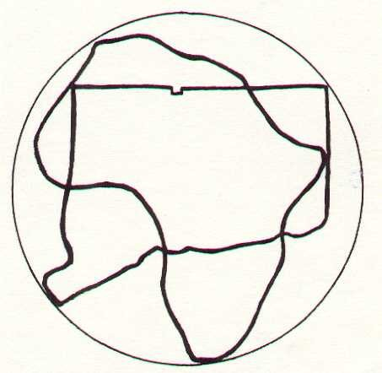
Black History Moment

Slide 2
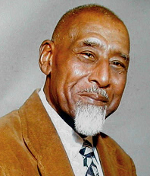
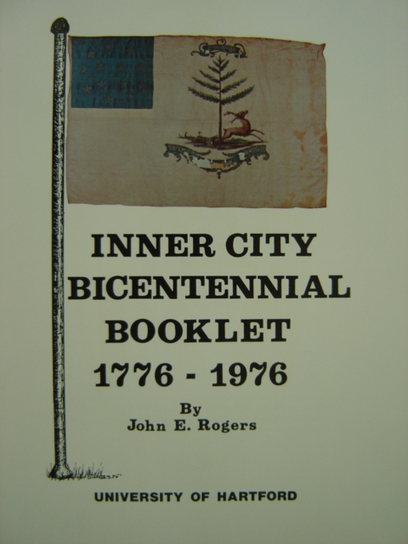
JOHN E. ROGERS
“The Father of Black
History in Connecticut”
1907-1982
Notes:
John E. Rogers was known throughout the state as “Doctor John” and is considered “The Father of Black History in Connecticut.” He had an honorary doctorate from the University of Hartford where he taught Black History. He also taught at Greater Hartford Community College. He grew up in Hartford, but raised his family in Manchester. Mr. Rogers travelled all over New England telling true stories and thrilling audiences of all ages with tales that no history books had yet recorded. Mr. Rogers, a self-taught scholar and expert on the colonial history of African-Americans in Connecticut and New England, made a point of lifting up the most awe-inspiring true histories that he found when reading the dusty books in the Connecticut State Library. More than the horrifying history of slavery in the North, Mr. Rogers made sure that everyone heard the uplifting and heroic stories of the men and women who lived here in captivity: Lucy Terry, Venture Smith, Dr. Primus Manumitt, the Black Governors elected by the slaves, and more. The month we will be learning about Black History in Connecticut thanks to Dr. Rogers.

Slide 3
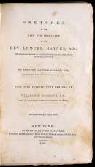
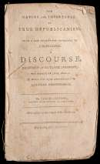
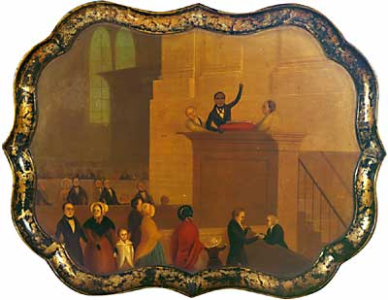
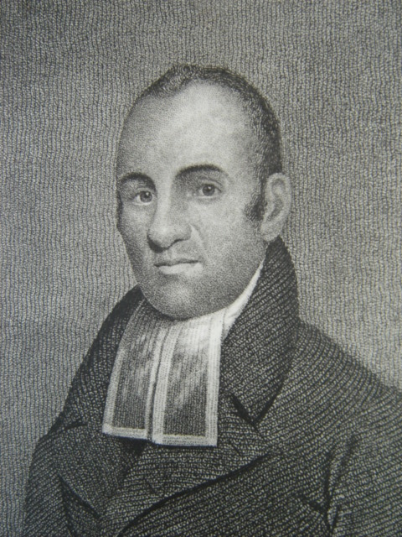
Reverend Lemuel Haynes
Minuteman, Teacher, Minister, Writer
Notes:
Dr. Rogers’ favorite historical person was Lemuel Haynes, the son of an African man and an Irish woman from Hartford, Connecticut. He became a minister after studying with Reverend Hezekiah Bissell, the earliest Congregational minister in Bloomfield, Connecticut. Lemuel Haynes was the first black minister in Torrington, CT. When the American Revolution broke out, Lemuel Haynes went to Boston as a Minuteman and fought the British at Fort Ticonderoga, New York, in 1775 with Ethan Allen and the Green Mountain Boys. After the war, Haynes became a famous and beloved minister all over New England and New York. His sermons were published and were read by many people. He moved to Vermont and had a church there where he was buried.

